Slide 1


Hope to Skills
Lecture# 11
Irfan Malik, Dr. Sheraz Naseer

Slide 2
Agenda
Recap
Machine Learning Pipeline
Types of Machine Learning
Types of Data
Data Preprocessing
Intro to Pandas

Slide 3
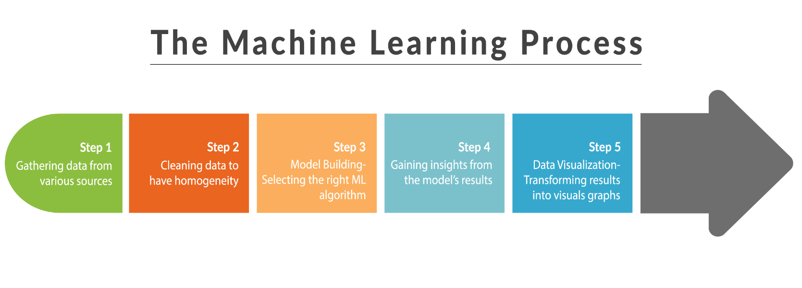

Slide 4
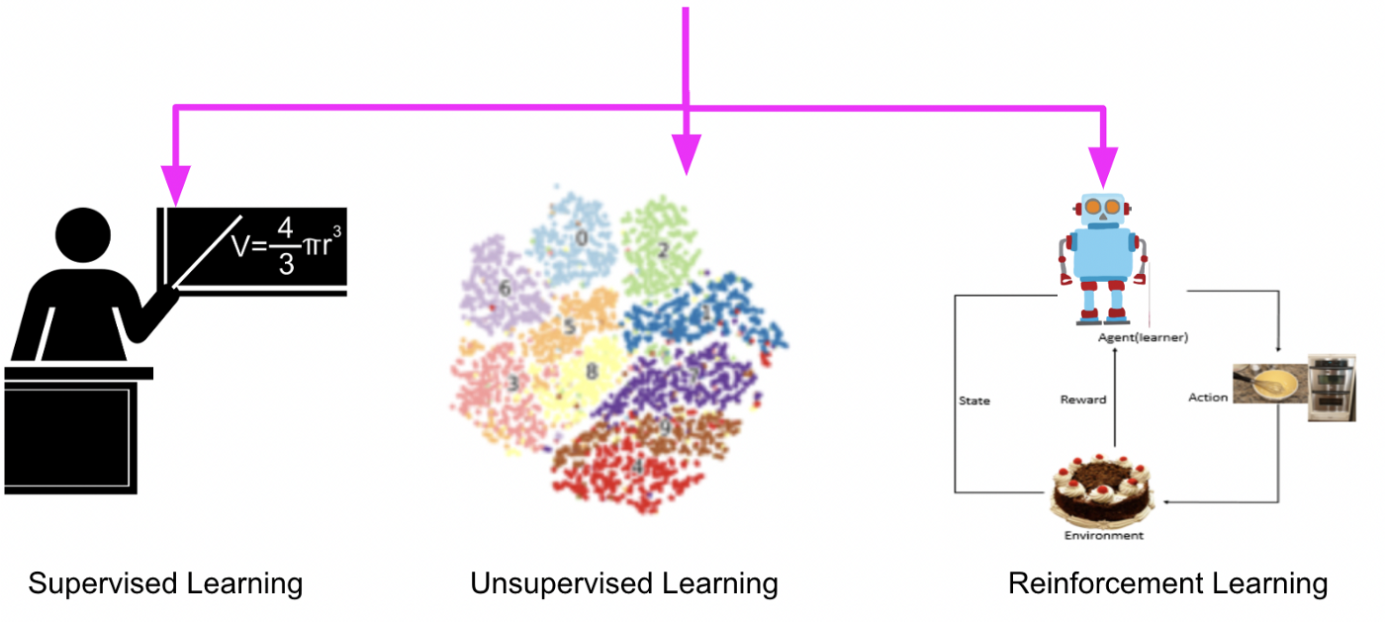
Types of Machine Learning
Supervised Learning (learning with labeled data)
Unsupervised Learning (discover patterns in unlabeled data)
Reinforcement learning (learn to act based on feedback/rewards)

Slide 5
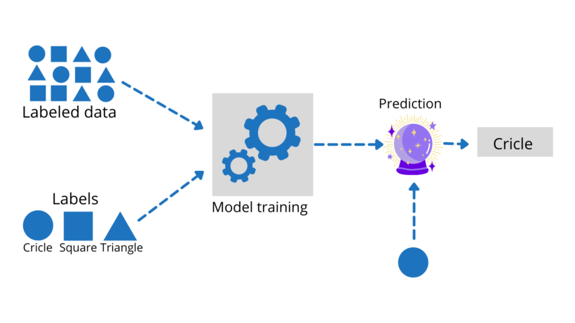
Supervised learning

Slide 6
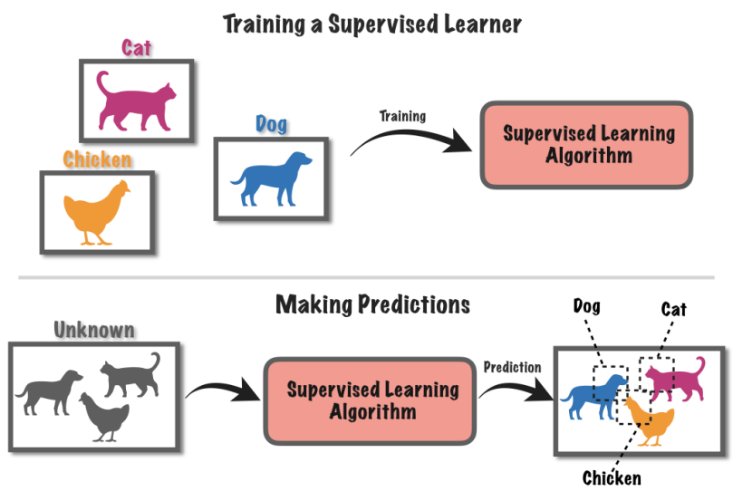

Slide 7
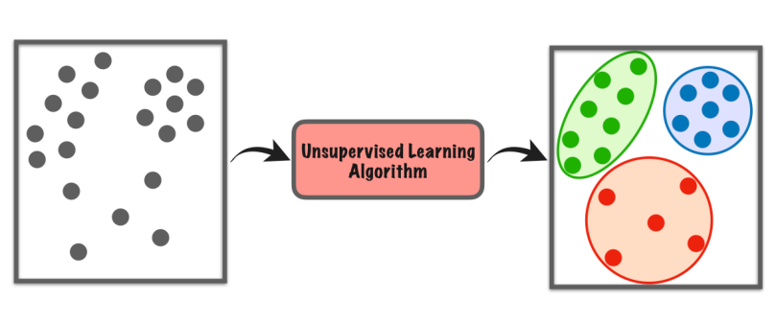
Unsupervised learning
Clustering
Dimensionality Reduction
Anomaly Detection

Slide 8
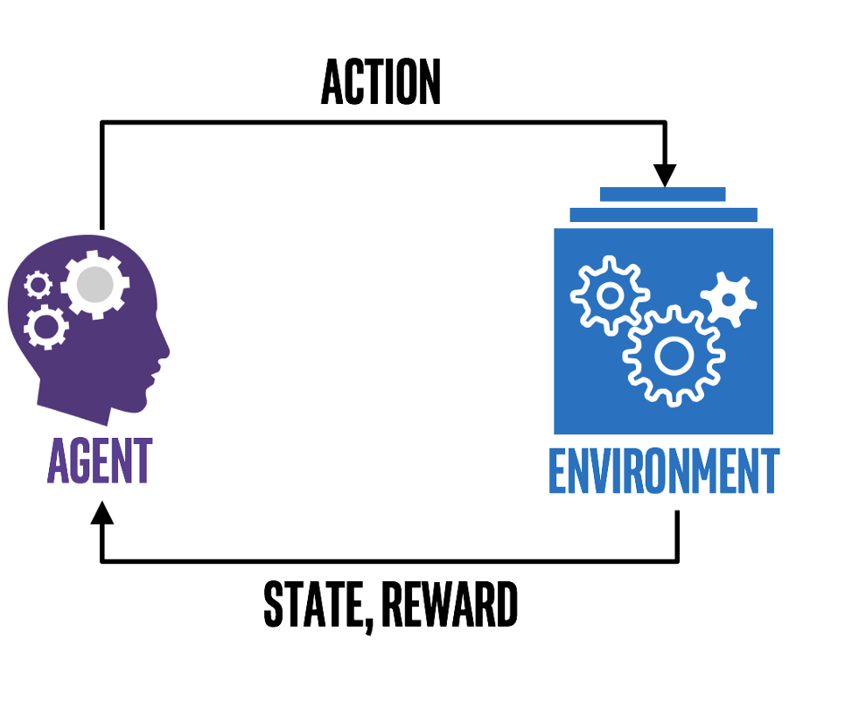
Reinforcement Learning

Slide 9
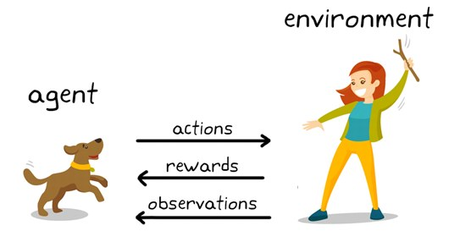
Reinforcement Learning

Slide 10
Types of Data

Slide 11
Structured Data
Structured data is organized and follows a predefined format, usually stored in databases or spreadsheets.
Example: A customer database with columns for name, age, email, and purchase history.
Ordinal data
Nominal data
Numerical data

Slide 12
Unstructured Data
Unstructured data is not organized and lacks a predefined format, often in the form of text, images, audio, or video.
Example: Social media posts, customer reviews, or images from a surveillance camera.

Slide 13
Semi-Structured Data
Semi-structured data has some organization but does not adhere to a strict schema, often containing tags or labels.
Example: Emails, JSON files that contain data with tags or key-value pairs.

Slide 14
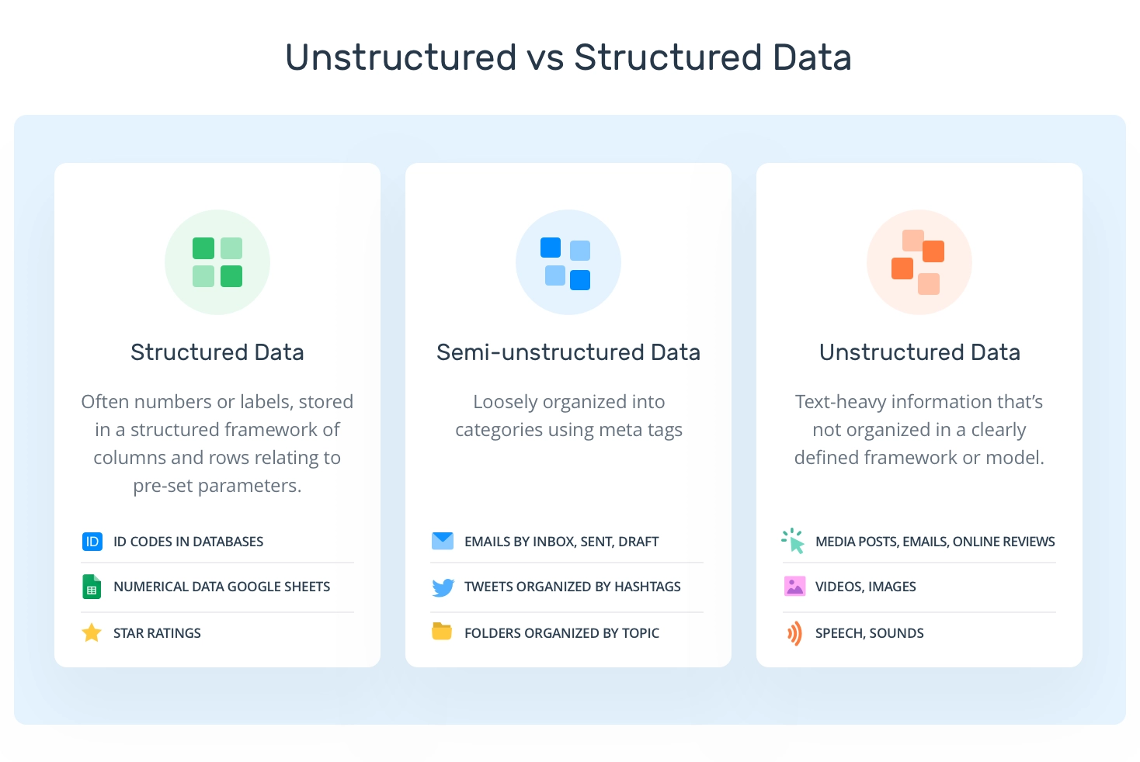

Slide 15
Data Preprocessing

Slide 16
What is Data Preprocessing?
Data preprocessing is the process of cleaning, transforming, and organizing raw data to make it suitable for analysis and machine learning models.
Importance: High-quality data preprocessing is crucial for accurate and meaningful insights.

Slide 17
Common Steps in Data Preprocessing:
Importing the Data
Handling Missing Data
Handling Duplicate Data
Handling Outliers
Encoding Categorical Variables
Scaling and Normalization

Slide 18
Introduction to Pandas
Pandas is an open-source library built on top of the Python programming language.
Pandas provides high-performance, easy-to-use data structures and data analysis tools.

Slide 19
Lets move to Google collab

